Slide 1

DEPARTMENT OF COMPUTER SCIENCE AND ENGINEERING NOISE POLLUTION MONITORING
Team name : Proj_224788_team_3
TEAM MEMBERS:
JANANI.V.V (113321104031)
JAYAPREETHA.S (113321104033)
JAYASRI.M (113321104034)
KAMIREDDY CHARITHA (113321104035)

Slide 2
Project
A sound level meter is employed for acoustic (sound that travels through the air) measurements. The simplest sort of microphone for sound level meters is the capacitor microphone, which mixes precision with stability and reliability. The diaphragm of the microphone responds to changes in air pressure caused by sound waves. That’s why the instrument is usually mentioned as a sound pressure level (SPL) Meter.
Sound level meters are commonly utilized in sound pollution studies for the quantification of various sorts of noise, especially for industrial, environmental, mining, and aircraft noise. The reading from a sound level meter doesn't correlate well to human-perceived loudness, which is best measured by a loudness meter. Specific loudness may be a compressive nonlinearity and varies at certain levels and certain frequencies. These metrics also can be calculated in several other ways.

Slide 3
Components Required
ESP8266 NodeMCU Board
Microphone sensor
16*2 LCD Module
Breadboard
Connecting wires

Slide 4
How does Microphone Module Work?
The microphone based sound sensor is used to detect sound. It gives a measurement of how loud a sound is. The sound sensor module is a small board that mixes a microphone (50Hz-10kHz) and a few processing circuitry to convert sound waves into electrical signals. This electrical signal is fed to on-board LM393 High Precision Comparator to digitize it and is made available at the OUT pin.
The module features a built-in potentiometer for sensitivity adjustment of the OUT signal. We will set a threshold by employing a potentiometer. So that when the amplitude of the sound exceeds the edge value, the module will output LOW, otherwise, HIGH. Apart from this, the module has two LEDs. The facility LED will illuminate when the module is powered. The Status LED will illuminate when the digital output goes LOW.

Slide 5
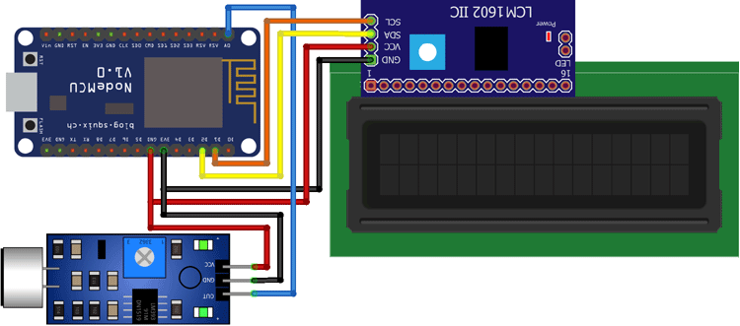
Circuit Diagram for IoT Sound Meter The connections are pretty simple, we just have to connect the sound sensor to one of the Analog pin and the LCD to the I2C pins.

Slide 6
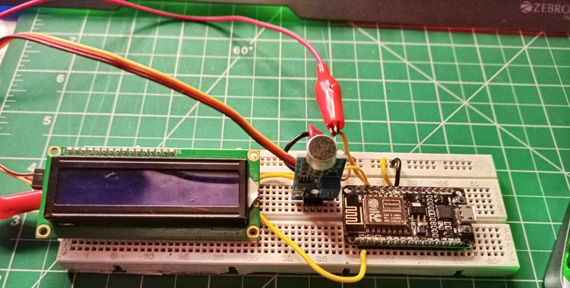
In the above diagram, we have connected the power pins of the sound sensor and LCD display to 3v3 and GND pin of NodeMCU. Along with that, we have also connected the SCL and SDA pins of the module to D1 and D2 respectively, and the OUT pin of the sound sensor to A0 pin.

Slide 7
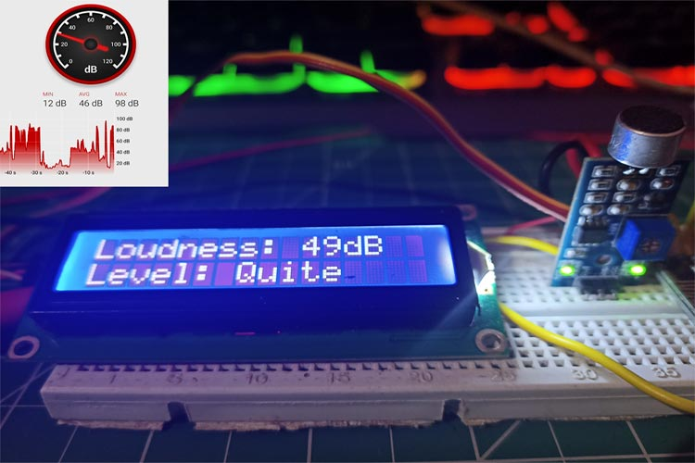
Working of the Project
The complete working of this project is also demonstrated . Hope you enjoyed the project and learned something useful.
To make sure the values are correct, I compared them to an android application on my phone that could measure sound. As you can see from the pictures, the results were quite close.

Slide 8
Sound Measurement Equipment: Noise monitoring typically begins with the use of specialized sound measurement equipment, such as sound level meters or noise dosimeters. These devices are designed to capture and record sound data accurately. Some common features of these instruments include microphones, preamplifiers, signal processing, and data storage capabilities.
Data Collection: Sound level meters and dosimeters are placed at various locations in the environment where noise pollution is of concern. This could be near highways, industrial areas, construction sites, residential neighborhoods, or other potentially noisy places. The devices continuously measure and record sound levels in decibels (dB).
Data Logging and Storage: Noise monitoring equipment can log and store sound level data over time, creating a continuous record of noise levels. This data can be stored locally on the device or transmitted to a central data repository for analysis.

Slide 9
Code implement for noise pollution monitoring
#define BLYNK_PRINT Serial #include <ESP8266WiFi.h> #include <BlynkSimpleEsp8266.h> #include <LiquidCrystal_I2C.h> #define SENSOR_PIN A0 LiquidCrystal_I2C lcd(0x3F, 2, 1, 0, 4, 5, 6, 7, 3, POSITIVE); const int sampleWindow = 50; unsigned int sample; int db; char auth[] = "IEu1xT825VDt6hNfrcFgdJ6InJ1QUfsA"; char ssid[] = "realme 6"; char pass[] = "evil@zeb"; BLYNK_READ(V0) { Blynk.virtualWrite(V0, db); } void setup() { pinMode (SENSOR_PIN, INPUT); lcd.begin(16, 2); lcd.backlight(); lcd.clear(); Blynk.begin(auth, ssid, pass); }

Slide 10
void setup() { pinMode (SENSOR_PIN, INPUT); lcd.begin(16, 2); lcd.backlight(); lcd.clear(); Blynk.begin(auth, ssid, pass); }
void loop() { Blynk.run(); unsigned long startMillis = millis(); // Start of sample window float peakToPeak = 0; // peak-to-peak level unsigned int signalMax = 0; //minimum value unsigned int signalMin = 1024; //maximum value // collect data for 50 mS while (millis() - startMillis < sampleWindow) { sample = analogRead(SENSOR_PIN); //get reading

Slide 11
from microphone if (sample < 1024) // toss out spurious readings { if (sample > signalMax) { signalMax = sample; // save just the max levels } else if (sample < signalMin)
signalMin = sample; // save just the min levels } } } peakToPeak = signalMax - signalMin; // max - min = peak-peak amplitude Serial.println(peakToPeak); db = map(peakToPeak, 20, 900, 49.5, 90); //calibrate for deciBels lcd.setCursor(0, 0); lcd.print("Loudness: "); lcd.print(db); lcd.print("dB"); {

Slide 12
if (db <= 50) { lcd.setCursor(0, 1); lcd.print("Level: Quite"); } else if (db > 50 && db < 75)
lcd.setCursor(0, 1); lcd.print("Level: Quite"); } else if (db > 50 && db < 75) { lcd.setCursor(0, 1); lcd.print("Level: Moderate"); } else if (db >= 75) { lcd.setCursor(0, 1); lcd.print("Level: High"); } delay(600); lcd.clear(); }

Slide 13
THANK YOU

